Slide 1
FATIGUE
Finite Life/Strength
Cumulative Fatigue Damage

Slide 2
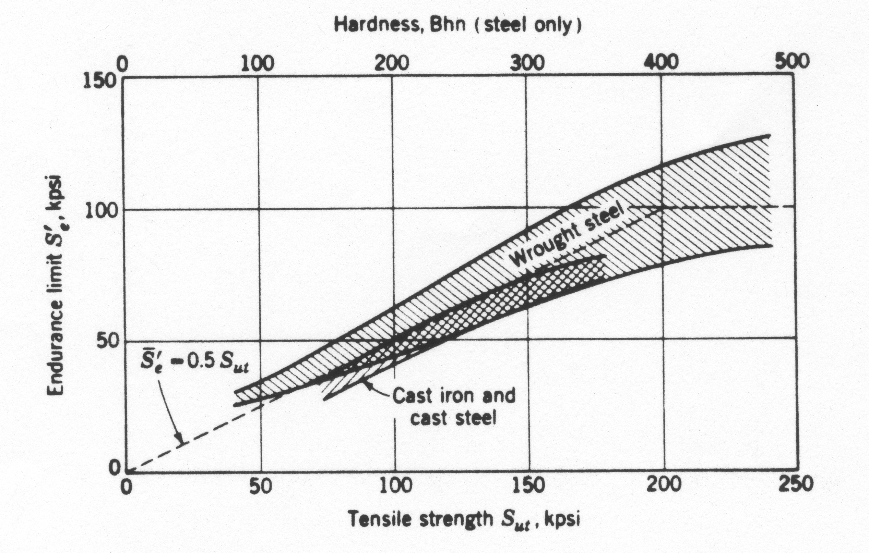
Endurance Limit and Strength

Slide 3
Rules of Thumb
Steel
English Units
Metric Units

Slide 4
Rules of Thumb
Cast Iron
Aluminum and Magnesium

Slide 5
Values (Reported by F.B. Stulen, H.N. Cummings, and W.C. Schulte, Preventing Fatigue Failures, Part 5, Machine Design, vol. 33, P. 161, 22 June 1961)
Material UNS No. (Alloys are heat treated, hot worked, specimens smooth, subjected to long life rotating beam test) | Tensile Strength, S_{ut} |  | Endurance Limit, S’_{E} |  | Standard Deviation
 | MPa | ksi | MPa | ksi | ksi | %
G43400 Steel | 965 1310 1580 1790 | 140 190 230 260 | 489 586 620 668 | 71 85 90 97 | 3.5 6.7 5.3 6.3 | 4.9 7.8 5.9 6.5
G43500 Steel | 2070 | 300 | 689 | 100 | 4.4 | 4.4
R50001-series Titanium Alloy | 1000 | 145 | 579 | 84 | 5.4 | 6.4
A97076 Aluminum Alloy | 524 | 76 | 186 | 27 | 1.6 | 6.0
C63000 Aluminum Bronze | 806 | 117 | 331 | 48 | 4.5 | 9.4
C17200 Beryllium Copper | 1210 | 175 | 248 | 36 | 2.7 | 7.5

Slide 6
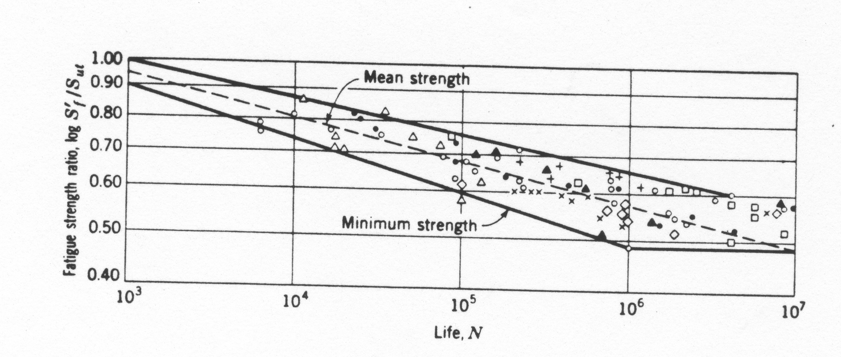
Finite Life, S’_{f}, The S-N Curve

Slide 7
Cumulative Damage Log-Log Plot
σ – Cyclic Stress Level
n – Number of Cycles
S’_{f} – Fatigue Strength at N
N – Number of Cycles to Failure given S’_{f}
S’_{e} - Endurance Limit
S_{ut}- Ultimate Strength
f⋅S_{ut}
n₁
σ₁
Fatigue Stress
S’_{e}
N₁
10³
10⁴
10⁵
10⁶
Cycles, N

Slide 8
Equation for the S-N Curve

Slide 9
Example
The endurance limit of a steel member is 112MPa and the tensile strength is 385MPa. What fatigue strength corresponds to a life of 70(10³) cycles.

Slide 10
Cumulative Damage
Multiple Stress Levels
σ₁ for n₁ cycles
σ₂ for n₂ cycles
Etc.
Palmgren-Miner’s Rule
n-nubmer of cycles of stress σ applied
N-life corresponding to σ
C-determined experimentally
0.7<C<2.2
Typically C=1

Slide 11
Example
Steel, S_{ut}=80ksi
3000 cycles at 60ksi
How many cycles remain at 50ksi and 40ksi?

